Slide 1
It’s about the Numbers
Boosting Student Performance
through Math Boot Camp:
Foundations for Student Success
mesacc.edu/fss
Notes:
MCC is one of the ten colleges in the Maricopa County Community College District (MCCCD). Established in 1965, MCC serves over 20,000 students each fall semester and over 18,000 students in the spring. MCC is also an emerging Hispanic Serving Institution with 28% of students identifying as Hispanic. The college’s mission statement includes excelling “in teaching, learning, and empowering individuals to succeed in our local and global community.”

Slide 2
Purpose of Math Boot Camp
mesacc.edu/fss
Strengthen and refresh math concepts
Reduce math anxiety
Improve placement test scores (using Next Gen Accuplacer)
Prep for entrance exams (HESI, ASVAB)
Foundations for Student Success
Notes:
The target audience for boot camp is students preparing for the Accuplacer placement test (first time test-takers and retesting); students trying to brush up on math skills before their fall semester math classes; and students studying for the HESI A2 nursing exam. Students who participate in all four days of boot camp are given a completion card and the ability to retest on Accuplacer if appropriate. Special test sessions are held immediately following the 4th class and the Math Department holds back seats in core math classes to ensure students who tested up would have a spot in a corresponding math class. We now use high school GPA as the primary placement mechanism so fewer students need take the Accuplacer.

Slide 3
Serving Students at Scale
mesacc.edu/fss
2 full-service campuses
Morning, afternoon, & evening options
Multiple weeks in the summer
Winter option
Online option
Foundations for Student Success
Notes:
Summer 2017 - 246 unique participants, 12 attended more than one session
Winter 2018 - 93 unique participants
Summer 2018 - 285 unique participants, 18 attended more than one session
Winter 2019 - 72 unique participants, 6 attended more than one session
Total=696

Slide 4
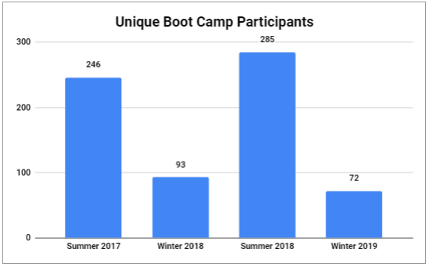
Number of Students Served
mesacc.edu/fss
Foundations for Student Success
Notes:
Summer 2017 - 246 unique participants, 12 attended more than one session
Winter 2018 - 93 unique participants
Summer 2018 - 285 unique participants, 18 attended more than one session
Winter 2019 - 72 unique participants, 6 attended more than one session
Total=696

Slide 5
How has boot camp impacted students?
mesacc.edu/fss
Builds confidence
Improves placement test scores
Boosts grades in math classes (participant grades higher than the department average)
Creates relationships between incoming students and Math Department (faculty and support staff)
Foundations for Student Success

Slide 6
What do students say?
mesacc.edu/fss
“I was able to grasp concepts that I haven’t for a decade.”
“Ready for math after 17 years.”
“I am investing in me!”
“Now I think I have a shot at math.”
“I feel a lot more prepared and refreshed to take the Accuplacer test.”
“Thank you for everything! You guys rock!”
Foundations for Student Success

Slide 7
Student Demographics
mesacc.edu/fss
Foundations for Student Success

Slide 8
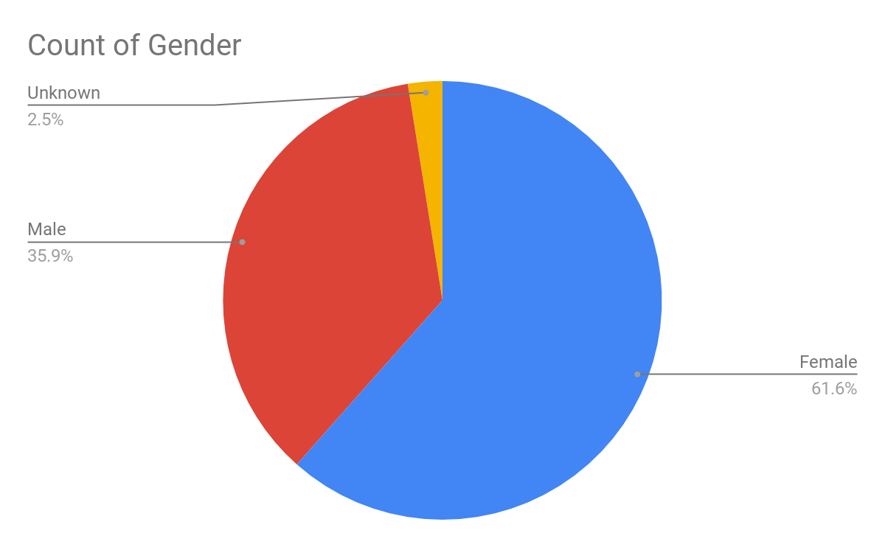
Student Demographics: Gender
mesacc.edu/fss
Foundations for Student Success

Slide 9
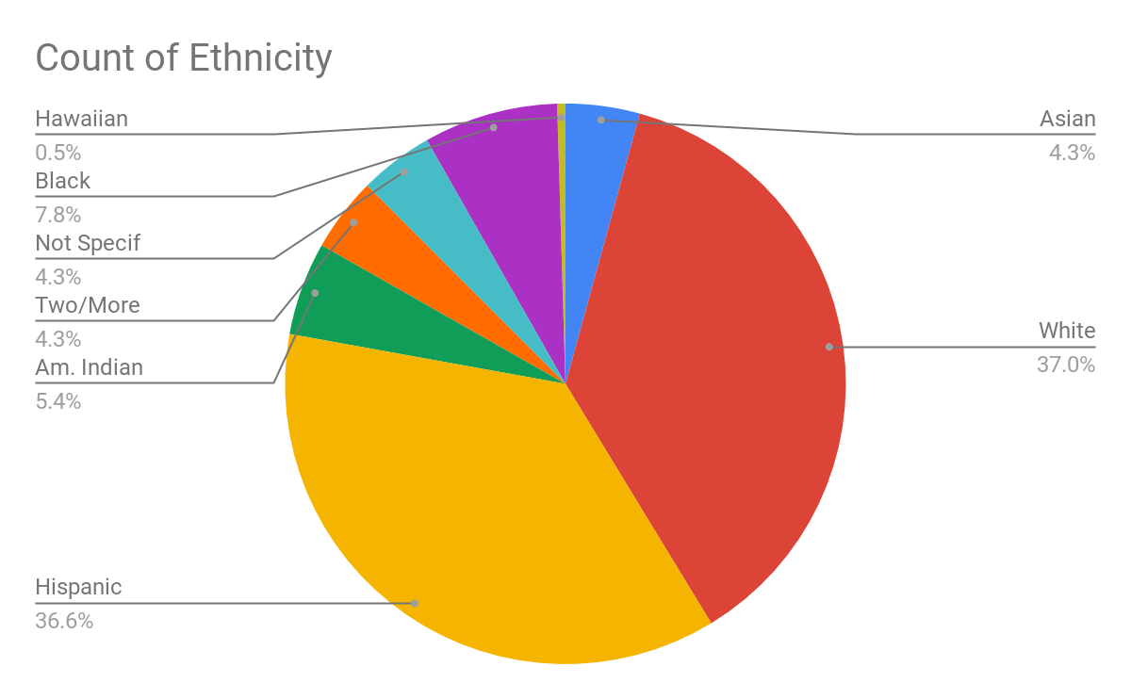
Student Demographics: Ethnicity
mesacc.edu/fss
Foundations for Student Success

Slide 10
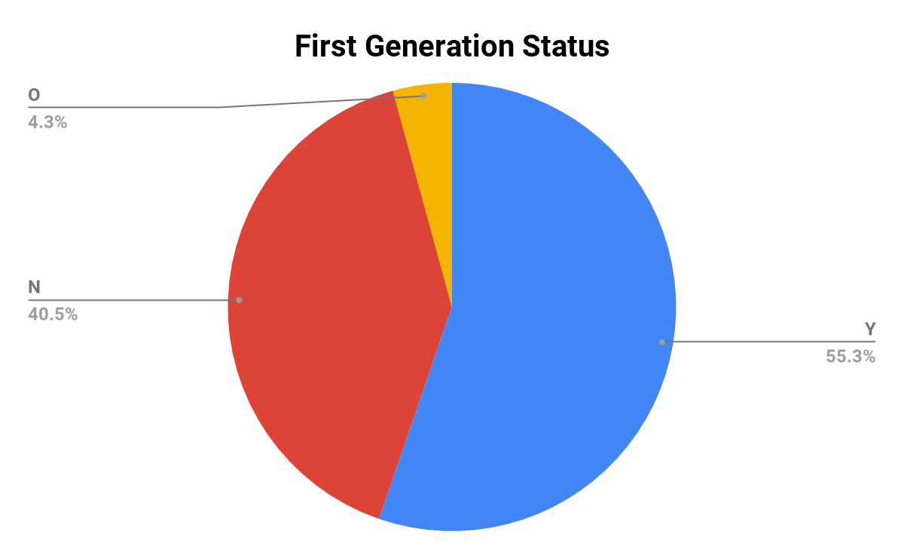
Student Demographics: First Gen Status
mesacc.edu/fss
Foundations for Student Success
Notes:
Mix of continuing and new students. Not highest performing students that seek this out; lots of students know they are weak in math and choose to come. Occasionally they have already failed a math class.

Slide 11
Course abbreviations
Course Title | Course Name
MAT 081,082,083 | Basic Arithmetic
MAT 090,091,092 | Introductory Algebra
MAT 108 | Tutored Mathematics
MAT 112 | Mathematical Concepts and Applications
MAT 120,121,122 | Intermediate Algebra
MAT 140,141,142 | College Mathematics
MAT 150,151,152 | College Algebra/Functions
MAT 182 | Plane Trigonometry
MAT 206 | Elements of Statistics
MAT 212,213 | Brief Calculus
MAT 220,221 | Calculus with Analytic Geometry I
MAT 231 | Calculus with Analytic Geometry II
MAT 241 | Calculus with Analytic Geometry III
MAT 298 | Special Projects

Slide 12
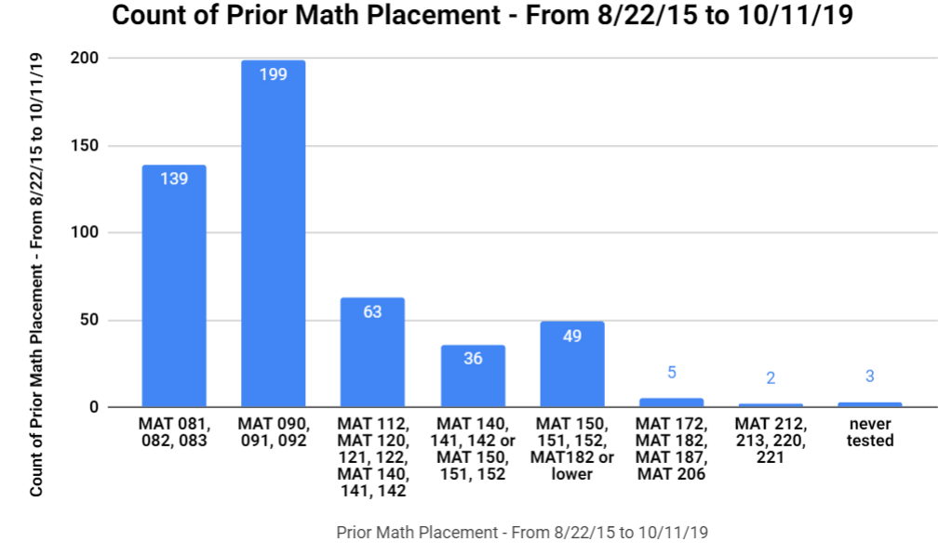
Initial Math Placement of Boot Camp Participants
mesacc.edu/fss
Foundations for Student Success

Slide 13
Initial Math Placement of Students Who Chose to (Re-)Take Placement Test After Boot Camp
mesacc.edu/fss
Foundations for Student Success

Slide 14
Math Placement for Students Testing After Boot Camp
mesacc.edu/fss
Foundations for Student Success

Slide 15
Math levels skipped overall
mesacc.edu/fss
Foundations for Student Success
Notes:
150 improved scores 62% of testers, 103 skipped at least 1 level 43% of testers
Improvement could not be determined in some cases because old test scores could not be compared to next gen scores

Slide 16
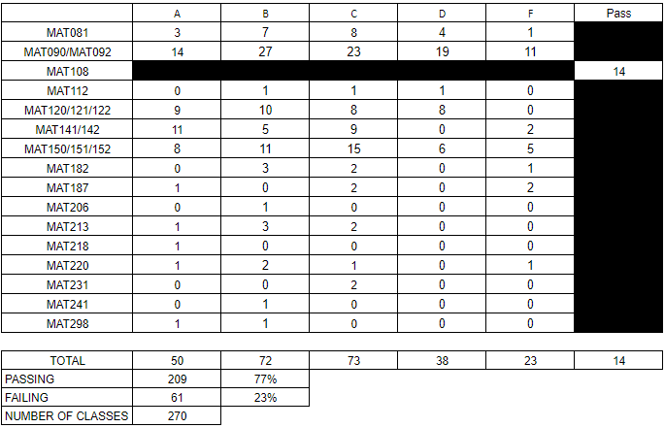
Fall 2018 Grades for Students Who Participated in Summer Boot Camp
mesacc.edu/fss
Foundations for Student Success
Notes:
Math course completion rates (college-wide) for Fall 2018 was 60%

Slide 17
Levels of Boot Camp
mesacc.edu/fss
Foundations for Student Success

Slide 18
Math Foundations 1: Ideal for students needing a review of Fractions, Decimals, and Percents.
Math Foundations 2: Ideal for students entering MAT12X Intermediate Algebra or MAT14X College Mathematics.
Math Foundations 3: Ideal for students entering MAT15X - College Algebra needing a review of Intermediate Algebra. Also open to students testing into MAT182/187 Trigonometry and Precalculus.

Slide 19
Foundations 1 Outline
mesacc.edu/fss
Day 1 | Day 2 | Day 3 | Day 4
Fractions | Fractions, Decimals, Percents | Ratios, Proportions (Optional: Geometry and Statistics) | Order of Operations Basic Solving Equations
Foundations for Student Success

Slide 20
Foundations 2 Outline
mesacc.edu/fss
Day 1 | Day 2 | Day 3 | Day 4
Basic Solving and Graphing Equations | Functions & Radicals | Exponents & Polynomials | Systems of Equations & Factoring
Foundations for Student Success

Slide 21
Foundations 3 Outline
mesacc.edu/fss
Day 1 | Day 2 | Day 3 | Day 4
Quadratics | Rationals | Radicals | Logarithms
Foundations for Student Success

Slide 22
Boot Camp Demo
mesacc.edu/fss
Foundations for Student Success

Slide 23
Foundations 2, Day 2
mesacc.edu/fss
Let’s go!
Game
Foundations 2 Day 2 Functions
Foundations for Student Success

Slide 24
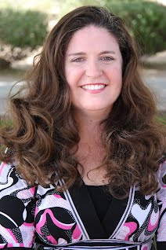
Almost Famous
mesacc.edu/fss
Foundations for Student Success

Slide 25
Final Thoughts
mesacc.edu/fss
Foundations for Student Success

Slide 26
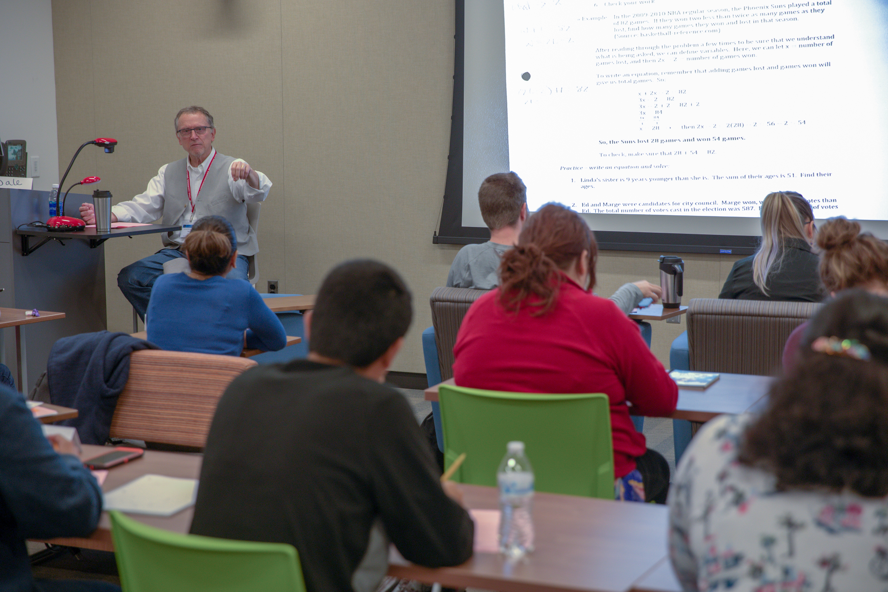
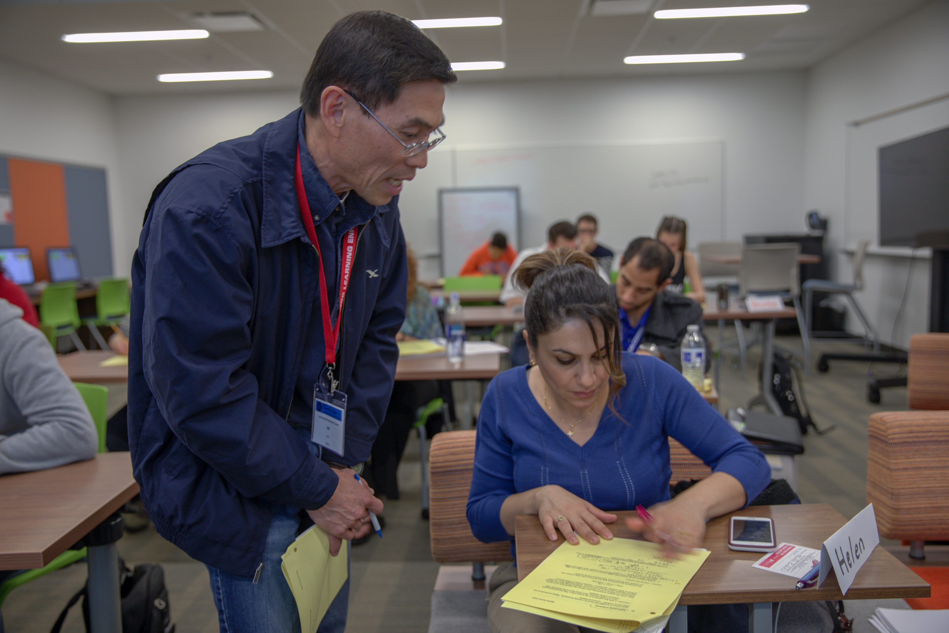
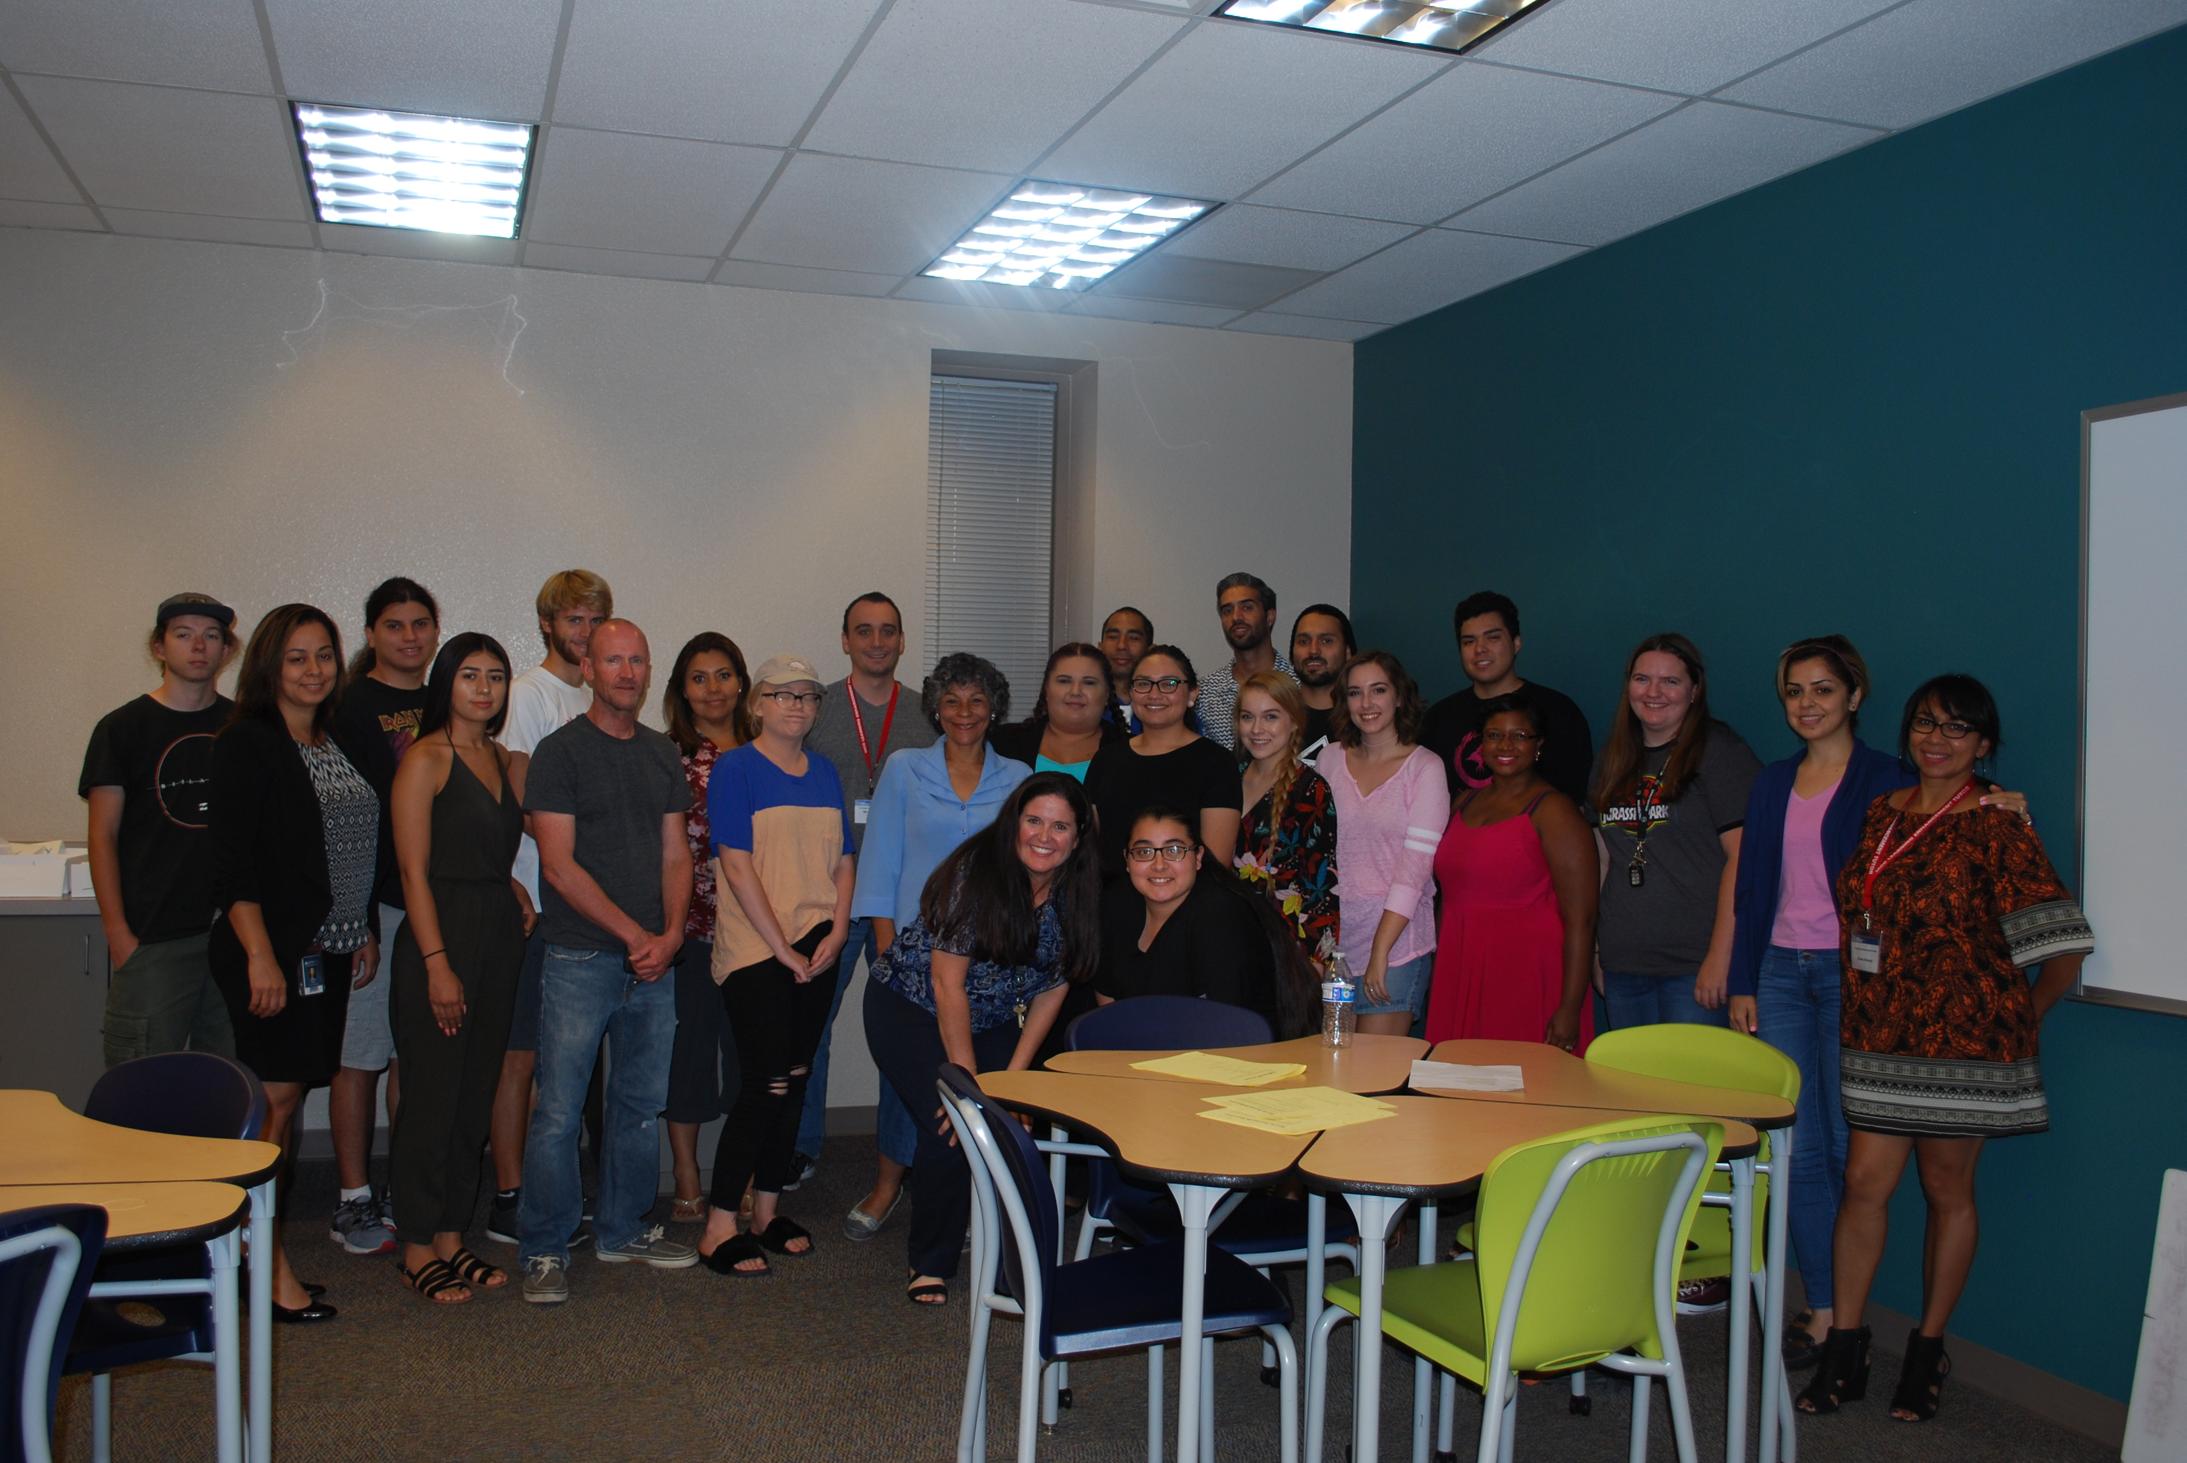
mesacc.edu/math-boot-camp

Slide 27
Challenges
mesacc.edu/fss
Then…
High demand (had to add double sessions the first summer)
Getting students registered into correct level (started with two levels and added third level)
Placement testing (student intention did not match actions)
Registration software
Now…
Lower demand? (Multiple Measures implemented Spring 2019)
Foundations for Student Success
Notes:
Students requesting multiple sessions; not knowing which level to take

Slide 28
Questions?
mesacc.edu/ fss
Foundations for Student Success

Slide 29
Mesa Community College Melissa Carpenter (melissa.carpenter@mesacc.edu)
Roxanne Klassen (roxanne.klassen@mesacc.edu)
Edwin Maldonado (edwin.Maldonado@mesacc.edu)
mesacc.edu/fss
Foundations for Student Success

